Slide 1
AutoRest: The Module Generator
The PoSh Wolf
https://github.com/theposhwolf/sessions

Slide 2
Who is The PoSh Wolf?
Anthony Howell
From Eugene, OR USA so I like to bike, eat granola, and grow out my beard
1 wife, 2 dogs, and 3 descendants
12+ years IT experience
Blogger (https://theposhwolf.com)
Twitter (https://twitter.com/theposhwolf)
Pluralsight author (https://pluralsight.com)
TechSnips contributor (https://techsnips.io)
Consulting (https://howell-it.com)
Employed (https://runway.host)

Slide 3
Runway
Agent based orchestration platform
Run any code anywhere (including PowerShell)
Fully API driven (with PowerShell SDK)
Supports Windows, Linux, and containers
Move data between any endpoints, no network requirements
We are invested heavily in PowerShell because I like PowerShell
If you want a free account, reach out
anthony@runway.host

Slide 4
I like PowerShell

Slide 5
Definitions
AutoRest
Ingests an OpenAPI definition file and spits out a language specific SDK
Supports: PowerShell, C#, Go, Java, Python, Swift, TypeScript
OpenAPI (f.k.a. Swagger)
A standard specification for defining APIs.

Slide 6
Examples of AutoRest modules
Azure PowerShell Modules: Azure/azure-powershell: Microsoft Azure PowerShell (github.com)
Microsoft Graph PowerShell SDK: microsoftgraph/msgraph-sdk-powershell: Powershell SDK for Microsoft Graph (github.com)

Slide 7
Overview
Brief setup of AutoRest & AutoRest.PowerShell
Overview of a simple OpenAPI file
Including Authentication and basic CRUD
Build a module
Adding Authentication
Adding cmdlets
Using directives for customization

Slide 8
Prerequisites
Node.js
Dotnet SDK 2.2
AutoRest
AutoRest.PowerShell
PowerShell 6+

Slide 9
Demo Environment
Previously mentioned prerequisites
Windows 10
VS Code (latest version)
PowerShell 7.2.2 (should work in Windows PowerShell 5.1)

Slide 10
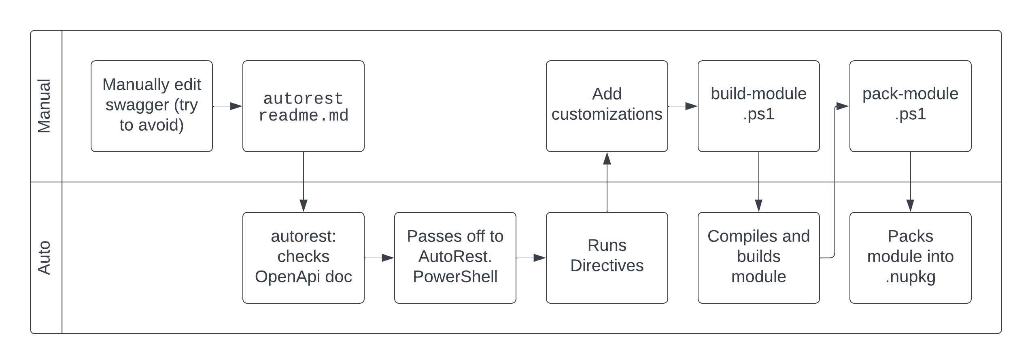
Workflow

